Slide 1
Summer theme park online booking system
Group 14
Keerthana J Bhavya G Ragamalika K

Slide 2

AGENDA
1. Aim
2.Problem Statement
3.Objective
4.Business Rules
5.Entity Relationship Diagram

Slide 3
Overview
The “SUMMER THEME PARK ONLINE BOOKING SYSTEM” is a DBMS project aimed at providing an online platform for tickets and room reservation. Its collects user information as input source and provides all the services and offers on the reservation. It allows flexibility during these processes.

Slide 4
Aim: The main aim of designing this project is to get rid from manual work and try to give easy and simple online reservation system for the users.
Aim:
The main aim of designing this project is to get rid from manual work and try to give easy and simple online reservation system for the users.
Problem Statement:
The Booking System highlights various features and services provided by the summer theme park, which can be subjected to improvements in the booking process.
A process to buy ticket is slowly that make our customer waste their time, so we open the system to buy ticket online.
Customer may have some problem or use service uncomfortably. We want a registration system to contain private information and serious thing is telephone number for contact.
After payment, the system should show the status of payment evident of transaction for the customers.
We should show the summary report for customers to inform the information and details.

Slide 5
Aim: The main aim of designing this project is to get rid from manual work and try to give easy and simple online reservation system for the users.
Objective: The main objective of this project is to develop a database which stores the user details. The user can book tickets and rooms through online. This project provides a convenient way for making payment. The admin has complete control as it provides and accept only appropriate and valid data. To display organized information of hotel, prices and pictures. To add multiple hotels/rooms to the system. To change type of hotel rooms when needed. It also helps to keep record of the details and history of the users, also way of maintaining and analyzing the data.

Slide 6
Business Rules
• Admin: Has access to all the information of website and user details
• Validating customer email in correct format
• Users: The user must provide their details
• A customer can book more than one ticket
• The customer can only have access to their booking details (contact information, reservation details of rooms, billing information)
• The customer can book any number of shows ,can buy souvenirs from the shop and price is calculated accordingly
• The customer can book any number of rooms with various views
• The customer can make payment and get a confirmation ticket

Slide 7
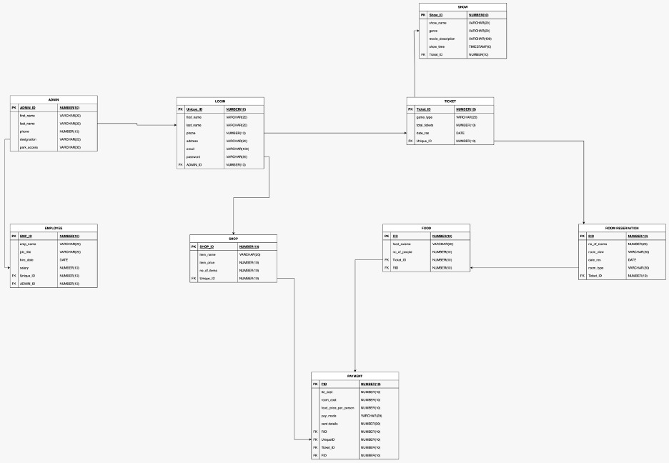
ER DIAGRAM

Slide 8
CONTRIBUTIONS
Keerthana J
Created Admin table and inserted values
Created Employee table and inserted values
Created Login table and inserted values
Created Customer detail view
Created employee detail view
Function to calculate total number of tickets sold
Function to find total cash payments
Package to find total cash payments
Package for updating customer password
Package to calculate employee bonus

Slide 9
CONTRIBUTIONS
Bhavya G
Created Shop table and inserted values
Created Ticket table and inserted values
Created Show movies table and inserted values
Created show movies details view
Created shop items details view
Indexes for employee name and show movie name
Trigger on inserting negative or empty salary
Trigger for email validation
Trigger to check if customer is entering all details (no null values)
Trigger to check if room type is null, if so, assign it as Standard type

Slide 10
CONTRIBUTIONS
Ragamalika K
Created Food table and inserted values
Created Room Reservation table and inserted values
Created Payment table and inserted values
Created show room reservation detail view
Created total payment view
Report for employees and their salaries
Report for all customers and their contact information
Report for show movies and show time
Report for shop items and it’s prices
Report for food ordered and room reservation details

Slide 11
THANK YOU

